Slide 1
God So Loves a Cheerful Giver

Slide 2
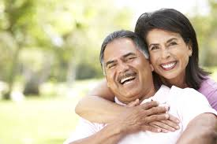
2nd Corithians 9:7
Each man should give what he has decided in his heart to give, not reluctantly or under compulsion, for God loves a cheerful giver.

Slide 3
GIVING
It is important that we should be obedient to God and give 10% of tithes each and every month.

Slide 4
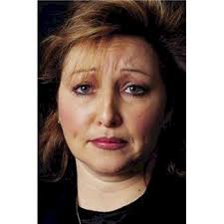
The truth
I think that if we are truthful with ourselves, we do not always give 10%, and we are not always cheerful when we give.

Slide 5
The truth
Please note that I know there are people in the Body of Christ that faithfully give 10% for their tithes and this is absolutely wonderful.
Keep on Giving ☺

Slide 6
The truth
According to Richard Stearns in his book, Unfinished on page 248, “Most Christians give far less than the ten percent that is the rule of thumb in the bible.” “About 2.5 percent is typical.”

Slide 7
The truth
If we are not cheerful to God when we give, I believe that God may not accept our gift.

Slide 8
Negative attitude
Some people have a negative attitude about tithing and think that when they give their money they are making the Pastor get richer.

Slide 9
The truth
If this is true, then leave the Pastor to the Lord. The Lord will discipline the Pastor – not you!

Slide 10
LUKE 18:12
Part of the verse is worded like this: I fast twice a week and give a tenth of all I get.
I think that it is good to fast twice a week and give a tenth of all you get, but keep it between you and God.
Let the Lord see you fast and give in Silence.

Slide 11
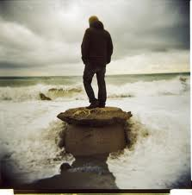
Luke 18:14 (Part of the verse)
For everyone who exalts himself will be humbled, and he who humbles himself will be exalted.

Slide 12
Closing remarks
Please Give God what is His and be sure to prepare your heart to be a cheerful giver for God.

