Slide 1
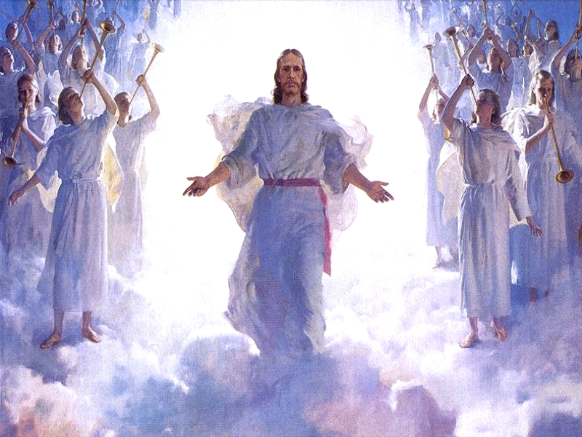
God’s Angels

Slide 2
Angel
An angel is a supernatural being or spirit, often depicted in humanoid form with feathered wings on their backs and halos around their heads, found in variousreligions and mythologies.
The term "angel" has also been expanded to various notions of spirits found in many other religious traditions. Other roles of angels include protecting and guiding human beings, and carrying out God's tasks.^{[2]}

Slide 3
Ministering spirits
As referenced in Hebrews 1:14 we keep coming back to angels are Ministering spirits sent to serve those who will inherit salvation. “Angels are here for us”.

Slide 4
Angels created
Angels were made before the third day of the creation week, the day when God gathered waters into seas and the dry land appeared. “Genesis 1:9-10

Slide 5
Heaven
Heaven is their dwelling place because angels belong to God.

Slide 6
Angels
Angels do not marry and do not procreate.

Slide 7
Hell’s Angels
When Satan was thrown out of heaven he took a third of God’s angels with him down to earth.
Now those angels are called Satan’s demons.

Slide 8
Demons
Demons are Satan’s Servants, and are comitted to his scheme to thwart the plan of God.

Slide 9
angels
Remember That Angels are created by God for our protection, assistance and salvation.
They are here to help us and we should embrace them as our friends.

