Slide 1
Rules for Holy Living
By Saint Paul

Slide 2
Colossians 3:2
Set your minds on things above, not on earthly things.

Slide 3
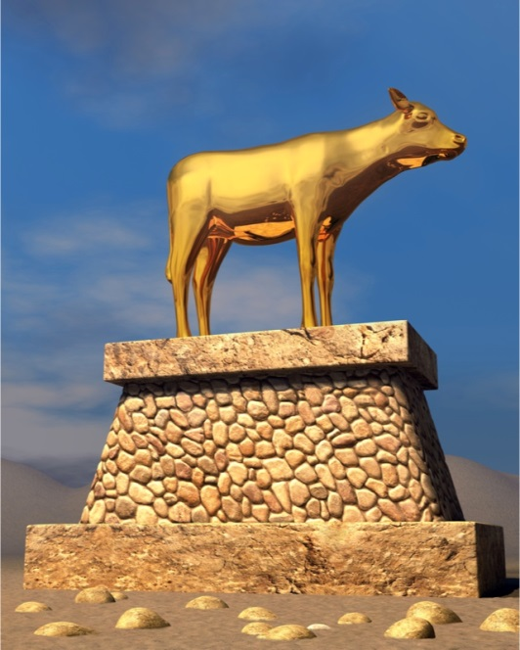
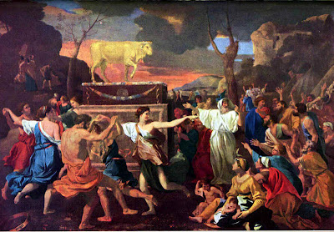
Colossians 3:5
Put to death, therefore, whatever belongs to your earthly nature: Sexual Immorality, Impurity, Lust, Evil desires and greed, which is idolatry.

Slide 4
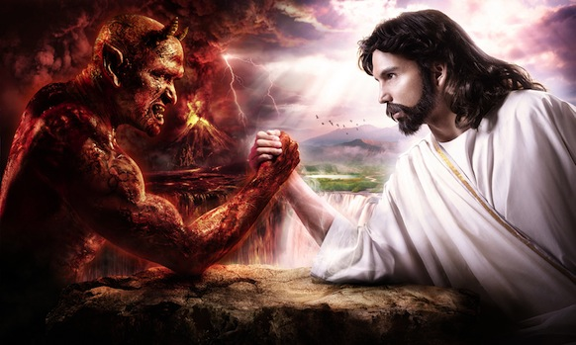
Colossians 3:6
Because of these, the wrath of God is coming.

Slide 5
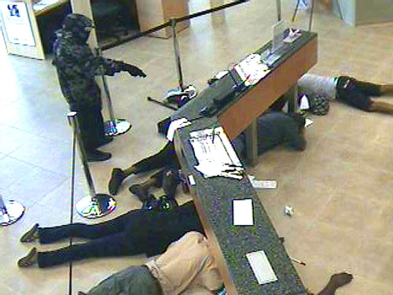
Colossians 3:7
You use to walk in these ways, in the life you once lived.

Slide 6
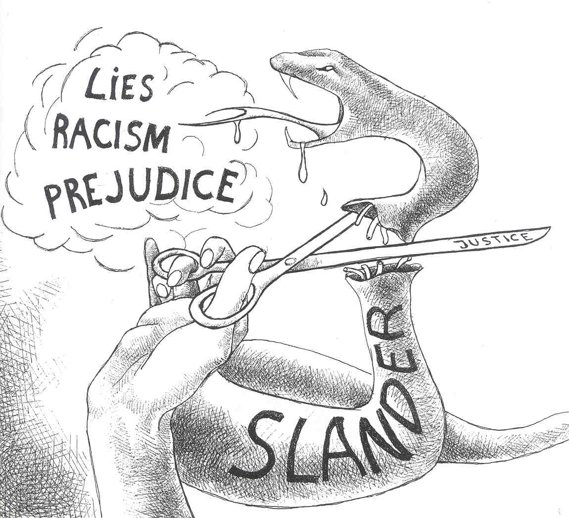
Colossians 3:8
But now you must rid yourself of all such things as these: anger, rage, malice, slander, filthy language from your lips.

Slide 7
Colossians 3:9-10
Do not lie to each other, since you have taken off your old self with it’s practices and have put on the new self, which is being renewed in knowledge in the image of it’s Creator.

Slide 8
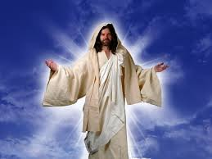
Colossians 3:12
Therefore, as God’s chosen people, holy and dearly loved, clothe yourselves with compassion, kindness, humility, Gentleness and Patience.

Slide 9
Colossians 3:13
Bear with each other and forgive whatever grievances you may have against one another. Forgive as the Lord forgave you.

Slide 10
Colossians 3:14
And over all these virtues put on love, which binds them all together in perfect unity.

Slide 11
Colossians 3:15
Let the peace of Christ rule in your hearts, since in members of one body you were called to peace. And be thankful.

Slide 12
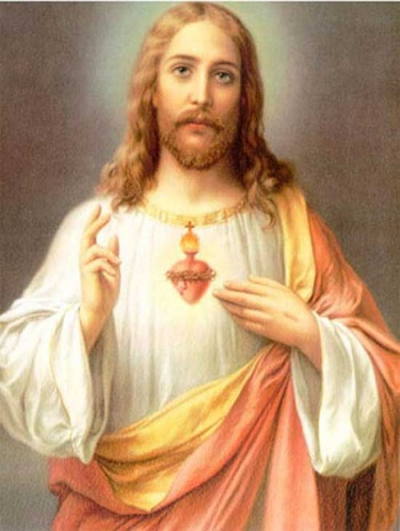
Colossians 3:17
And whatever you do, whether in word or deed, do it all in the name of the Lord Jesus, giving thanks to God the Father through him.

