Slide 1
Don’t Give God Lip Service

Slide 2
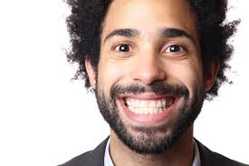
When you are praying don’t tell God only what he wants to hear. Tell him the truth.

Slide 3
God does not want us to be sound like broken records when we pray to him.

Slide 4
I don’t think he wants to hear the same thing over and over again. (Repetitive Prayer).

Slide 5
God wants us to have a relationship with him and he listens to every one of your prayers.

Slide 6
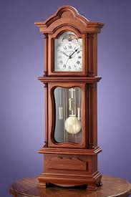
God does answer prayer but he answers prayer on his own time table.

Slide 7
Pray everyday and don’t give up when you are waiting to hear from Him. Tell God you want to have a closer walk with him.

