Slide 1
Purified By The Blood of Jesus

Slide 2
Hebrews 9:13-14 The blood of goats and bulls and the ashes of a heifer sprinkled on those who are ceremonially unclean sanctify them so that they are outwardly clean. How much more, then, will the blood of Christ, who through the eternal Spirit offered himself unblemished to God, cleanse our consciences from acts that lead to death, so that we may serve the living God!

Slide 3
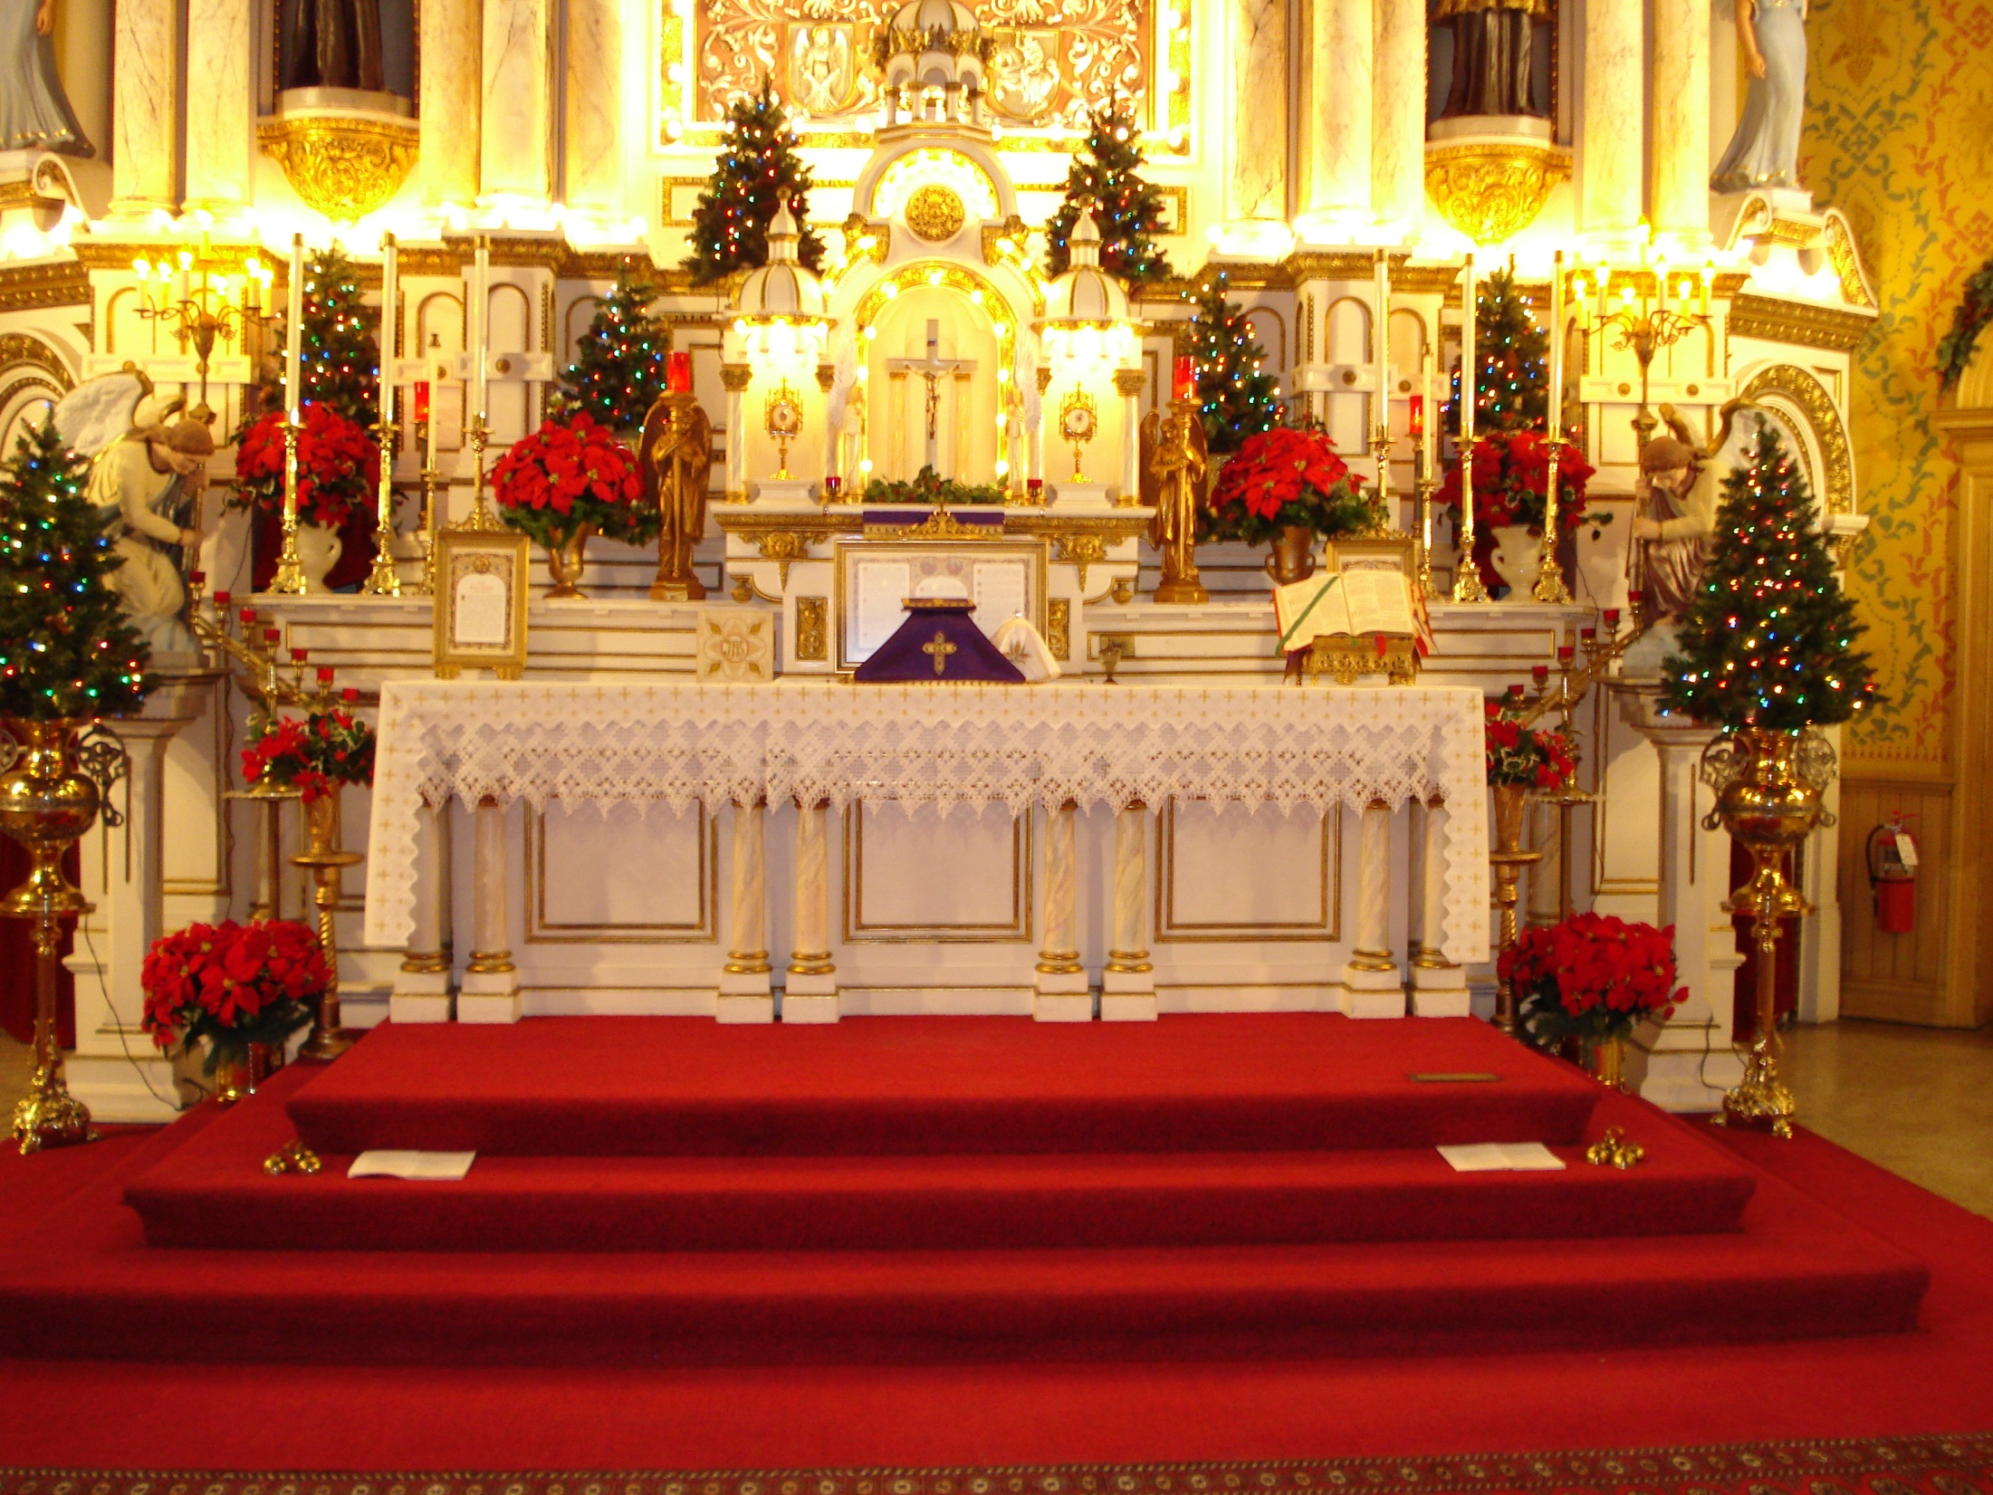

Slide 4
1 John 1:7 But if we walk in the light, as he is in the light, we have fellowship one with another, and the blood of Jesus Christ his Son cleanse us from all sin.

Slide 5
Hebrews 10:19 Having therefore, brethren, boldness to enter into the holiest by the blood of Jesus.

Slide 6
Confess your sins
Ask the lord for forgiveness
Ask the lord to cover all your sins with the precious blood of the lamb.
Ask the lord to cleanse you with the blood of the lamb of all unrighteousness.

